Slide 1
Electronic Devices
FAIRUZ ZAHIN SNEHA
ID:20-41912-1
Section : J
Department : CSE
Semester: 5th

Slide 2
Topic:- Operation of full wave centre tapped rectifier

Slide 3
Full Wave Rectifier
A circuit that converts the complete applied ac signal into pulsating dc is known as full wave rectifier.
*It uses both the halves of the ac signal and generates a pulsating dc output.

Slide 4
Full Wave Rectifier
Centre Tapped Full Wave Rectifier
Bridge Full Wave Rectifier

Slide 5
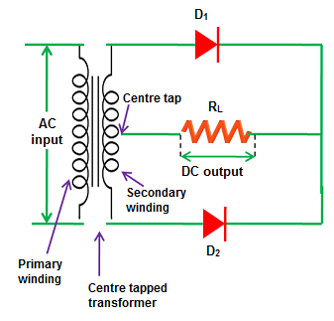
Operation of full wave centre tapped rectifier

Slide 6
During positive half-cycles

Slide 7
During negative half-cycles

Slide 8

The End

